Slide 1
LOGICAL GATES
NOT Gate
AND Gate
OR Gate
NAND Gate
NOR Gate
EXOR Gate
EXNOR Gate
Implementing logic circuits from logical expressions

Slide 2
LOGICAL GATES
Gates are the basic components of logical circuits. Gates are electronic circuits that perform Boolean operations. Input(s) of logical gates are variable values (0/1 or 0V/+5V) and the output is the result of the Boolean operation.
Gates are built with transistors, diodes, resistors, and capacitors. They are sold in the form of integrated circuits.
There are 7 basic gates:
AND, OR, NOT,
NAND, NOR,
EXOR, and EXNOR gates.

Slide 3


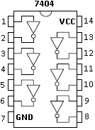
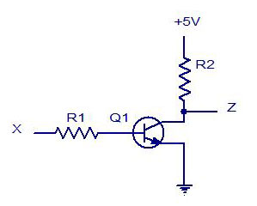
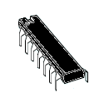
NOT Gate
NOT gate complements the input signal. It outputs 1 when the input is 0, and outputs 0 when the input is 1. It is represented with the following symbols.
Truth Table
Electronic Circuit
Logical Expression
x | y
0 | 1
1 | 0

Slide 4
NOT Gate
Example: If we input the signal x to a NOT gate, the output signal (y) would be as shown in the timing diagram below.
x
1
0
t
y
1
0
t

Slide 5
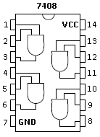


AND Gate
AND gates performs the Boolean AND operation. It has two inputs and a single output. It is represented with the following symbols.
Truth Table
Logical Expression:
x | y | z
0 | 0 | 0
0 | 1 | 0
1 | 0 | 0
1 | 1 | 1

Slide 6
AND Gate
Example: If we input the signals x and y to an AND gate, the output signal (z) would be as shown in the timing diagram below.
Remember that, AND operation is the equivalent of binary multiplication.
0∙0 = 0, 0∙1 = 0, 1∙0 = 0, 1∙1 = 1
x
1
0
t
y
1
0
t
z
1
0
t

Slide 7
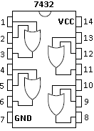


OR Gate
OR gates performs the Boolean OR operation. It has two inputs and a single output. It is represented with the following symbols.
Truth Table
Logical Expression
It is similar to binary addition, but the output is 1 when both inputs are 1.
x | y | z
0 | 0 | 0
0 | 1 | 1
1 | 0 | 1
1 | 1 | 1

Slide 8
OR Gate
Example: If we input the signals x and y to an OR gate, the output signal (z) would be as shown in the timing diagram below.
x
1
0
t
y
1
0
t
z
1
0
t

Slide 9
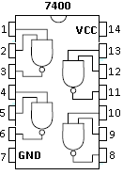



NAND Gate
NAND gates are universal gates. We can implement AND, OR, and NOT gates with NAND gates. We can consider NAND gates as AND gates which have a NOT gate right after the output. It is represented with the following symbols.
Truth Table
Logical Expression
NAND gate outputs 0 if all the inputs are 1. All the other combinations make the gate output 0.
x | y | z
0 | 0 | 1
0 | 1 | 1
1 | 0 | 1
1 | 1 | 0

Slide 10


NAND Gate
If we input the signals x and y to an NAND gate, the output signal (z) would be as shown in the timing diagram below.
There’s a similarity between OR gate and NAND gate. OR gate outputs 1 if at least one input is 1, and NAND gate outputs 1 if at least one input is 0.
x
1
0
t
y
1
0
t
z
1
0
t

Slide 11



NOR Gate
NOR gates are universal gates just like NAND gates. We can consider NOR gates as OR gates which have a NOT gate right after the output. It is represented with the following symbols.
Truth Table
Logical Expression
NOR gate outputs 1 if all the inputs are 0. All the other combinations make the gate output 0.
x | y | z
0 | 0 | 1
0 | 1 | 0
1 | 0 | 0
1 | 1 | 0

Slide 12


NOR Gate
If we input the signals x and y to an NOR gate, the output signal (z) would be as shown in the timing diagram below.
There’s a similarity between AND gate and NOR gate. AND gate outputs 1 if all the inputs are 1, and NOR gate outputs 1 if all the inputs are 0.
x
1
0
t
y
1
0
t
z
1
0
t

Slide 13


EXOR Gate
EXOR gate can be implemented with AND and OR gates. But since we need this operation frequently, there’s a basic logic gate for it. It checks if the inputs are different or not. It is represented with the following symbols.
Truth Table
Logic Expression
If an EXOR gate has more than two inputs, when we input an odd number of 1’s, the output will be 1.
E.g. 1 ⊕ 0 ⊕ 1 ⊕ 1 = 1, 1 ⊕ 0 ⊕ 1 ⊕ 1 ⊕ 1 = 0,
We can apply associative law. a⊕(b⊕c) = (a⊕b)⊕c = a⊕b⊕c
x | y | z
0 | 0 | 0
0 | 1 | 1
1 | 0 | 1
1 | 1 | 0

Slide 14
EXOR Gate
If we input the signals x and y to an EXOR gate, the output signal (z) would be as shown in the timing diagram below.
x
1
0
t
y
1
0
t
z
1
0
t

Slide 15


EXNOR Gate
EXNOR gate can be implemented with AND and OR gates just like EXOR gate. It checks if inputs are the same or not. It is represented with the following symbols.
Truth Table
Logic Expression
EXNOR gate is the complement of EXOR gate.
If an EXNOR gate has more than two inputs, when we input an even number of 1’s, the output will be 1.
E.g. 1 ⊗ 0 ⊗ 1 ⊗ 1 = 0, 1 ⊗ 0 ⊗ 1 ⊗ 1 ⊗ 1 = 1,
We can apply associative law. a⊗(b ⊗ c) = (a ⊗ b) ⊗ c = a ⊗ b ⊗ c
x | y | z
0 | 0 | 1
0 | 1 | 0
1 | 0 | 0
1 | 1 | 1

Slide 16
EXNOR Gate
If we input the signals x and y to an EXNOR gate, the output signal (z) would be as shown in the timing diagram below.
x
1
0
t
y
1
0
t
z
1
0
t

Slide 17
Implementing Logic Circuits From Logical Expressions
First, we check if we need complements of any variables. If we need the complement of a variable, we tie up NOT gates to those variables.
Then, we start implementing the circuit from the last logical operation and continue backwards.
We must be careful about the priorities in the expression. Parentheses have the highest priority. NOT operation has the next highest priority. And finally, AND operation has higher priority than OR operation.
Priorities:
Parentheses > NOT > AND > OR

Slide 18
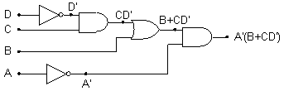
Implementing Logic Circuits From Logical Expressions
Example: Let’s implement the logic circuit of F = A’ (B+CD’)
First, we check the complements of variables. It can be seen in the expression that, we need A’ and D’. So we tie up NOT gates to these variables. Then we start from the last operation: A’ AND (B+CD’). We place an AND gate and tie up A’ to one of the inputs. Next operation we must consider is B OR CD’. So, we put an OR gate and tie up B to one of the inputs, and also tie up the output of OR gate to the other input of the AND gate we placed before. Next, we implement C AND D’ the same way.

